Slide 1
MGMT 6057 contemporary business management
Module 2: economics and business

Slide 2
Agenda
What is economics?
National economic systems: planned, free market, mixed
Competition and price-setting (supply and demand, four types of competition structures)
Measuring the health of the economy: growth, employment, price stability
Government role in managing the economy: monetary policy, fiscal policy
Government deficits, surpluses, and debt
Relevance for business owners and project managers

Slide 3

What is economics?
Economics: how individuals, businesses, governments and nations allocate LIMITED resources to satisfy their UNLIMITED wants and needs
Resources = Factors of production used to produce outputs
Land
Labour
Capital (money)
Entrepreneurship
Notes:
http://images.clipartpanda.com/economist-clipart-economics-free-clipart-1.jpg

Slide 4
Economic systems: planned systems
Government controls production and allocation of goods and services
Communism:
Government owns all or most enterprises
Government allocates resources, goods, services
Extensive government involvement in business
No private property
Socialism:
Government owns “essential” businesses and provides public social programs (e.g., unemployment income, health care, education)
Private businesses exist but are regulated and taxed

Slide 5
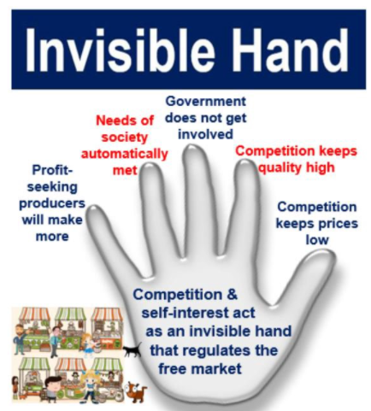
Economic systems: free markets
Capitalism
Most businesses are privately owned
Competition determines allocation of goods and services
Adam Smith - “Invisible hand”
Owners entitled to profits

Slide 6
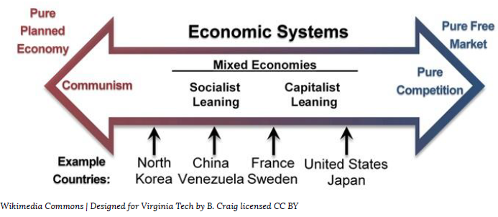
Economic systems: mixed economies
Both private enterprise and government ownership
Nearly all countries are mixed economies

Slide 7
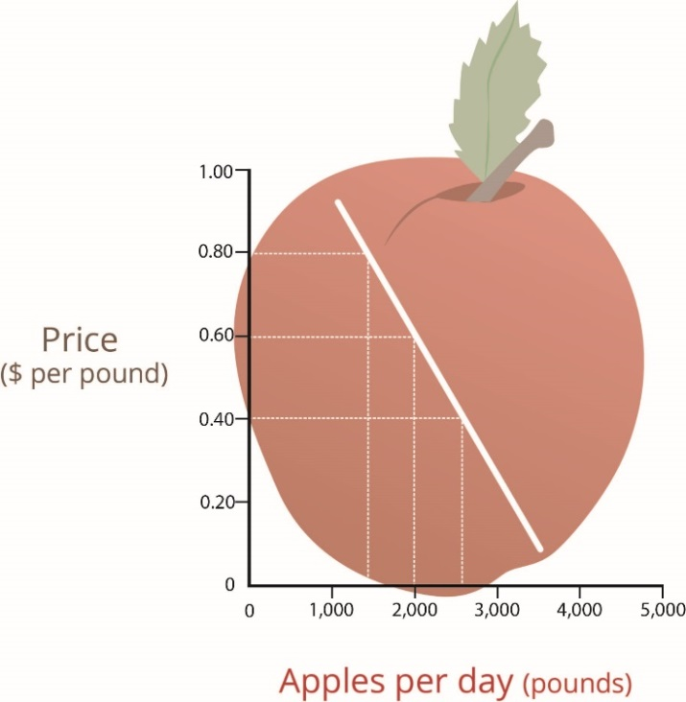
how prices are set in a free market system: Supply and demand
Demand curve – shows how much consumers are willing to purchase at every price
What factors affect the demand curve?
Customer preferences
Price of substitute goods
Price of complementary goods
Future expectations
Number of buyers
Incomes
Steep versus shallow demand curves (price elasticity): steep = inelastic demand, shallow = elastic demand

Slide 8
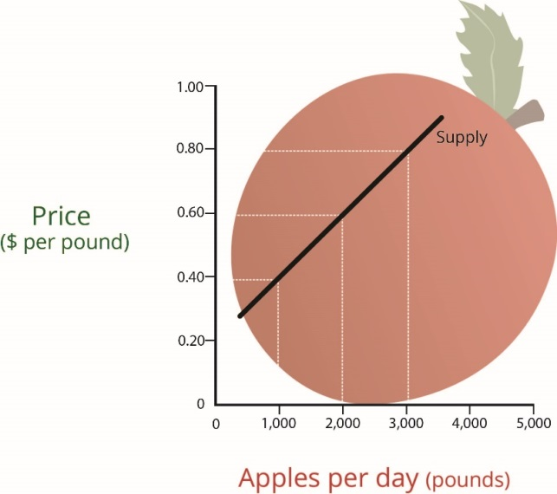
how prices are set in a free market system: Supply and demand
Supply curve – shows how much businesses are willing to produce at every price
What factors affect the supply curve?
Costs of goods
Costs of labour
Taxes
Weather
Costs of technology
Availability of suppliers

Slide 9
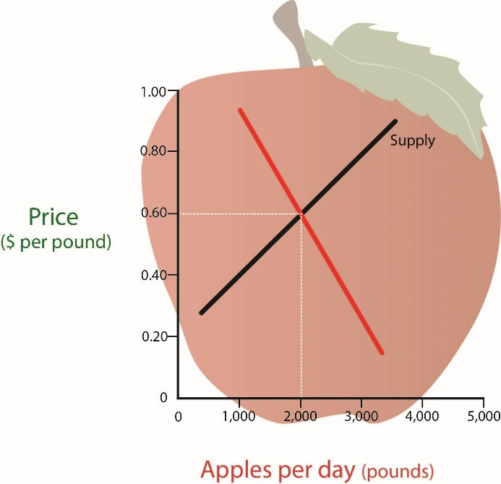
how prices are set in a free market system: Supply and demand
Equilibrium price – price at which consumers are willing to purchase everything a business is willing to make
No surplus
No shortage

Slide 10

Supply and demand
Consider the market for lemonade.
What happens when:
There is a heat wave
The price of sugar goes up
The cost of a can of soda falls
There is a baseball game on the street
Notes:
http://www.talkaboutgiving.org/wp-content/uploads/2011/09/Lemonade-Stand.jpg

Slide 11
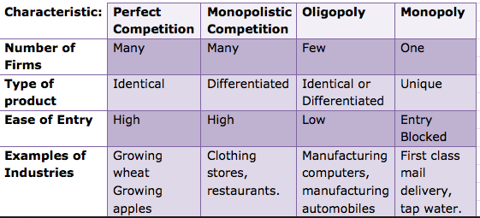
Types (structures) of competition
(May be “natural” or “legal” monopoly)
Notes:
https://classconnection.s3.amazonaws.com/708/flashcards/870708/png/screen_shot_2012-02-25_at_3.11.09_pm1330204287486.png

Slide 12
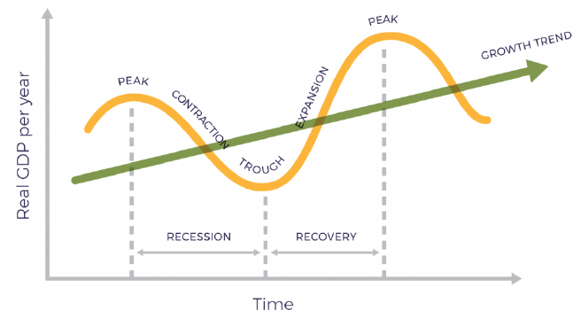
Measuring the economy: growth
Gross Domestic Product (GDP)
Value of all goods and services produced for all domestic consumers
Changes in GDP over time form the ‘Business Cycle’ (or ‘Economic Cycle’)

Slide 13
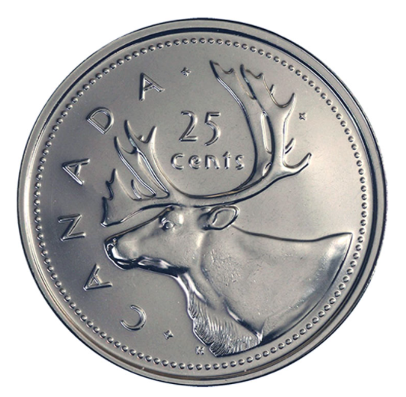
Measuring the economy: growth (GDP)

Slide 14
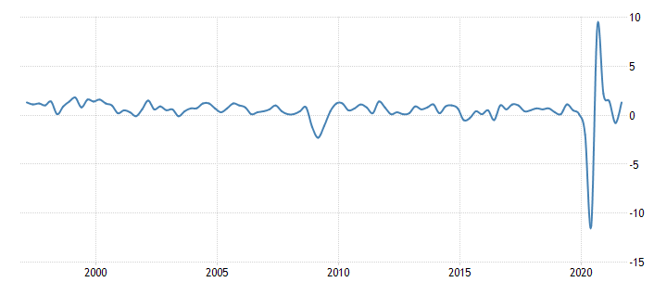
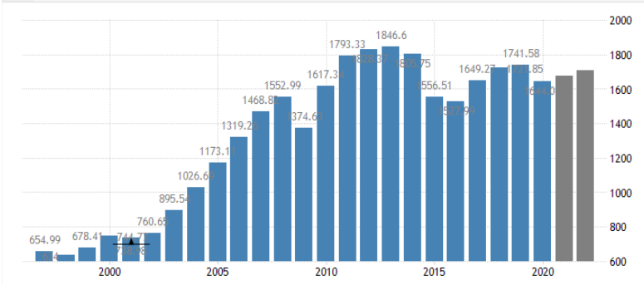

Canada’S gdp
Canada’s GDP: ~$2 trillion ($2,000,000,000,000) CAD
~$55,000 CAD per capita (2020)
Notes:
https://tradingeconomics.com/
GDP per capita from World bank

Slide 15

Measuring the economy: employment
Unemployment rate
Percent unemployed and actively seeking work (but there are other formulas for unemployment rate, too)
Full employment
Everyone who wants a job can get one
4% unemployment considered “full” employment
Notes:
http://transitionculture.org/wp-content/uploads/jobs.jpg

Slide 16
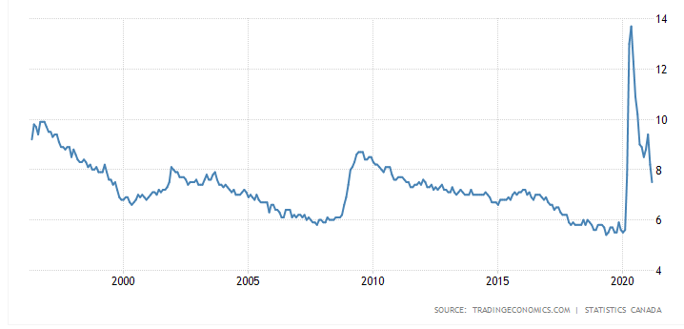
Unemployment rates in canada
Notes:
Source: https://tradingeconomics.com/canada/unemployment-rate

Slide 17

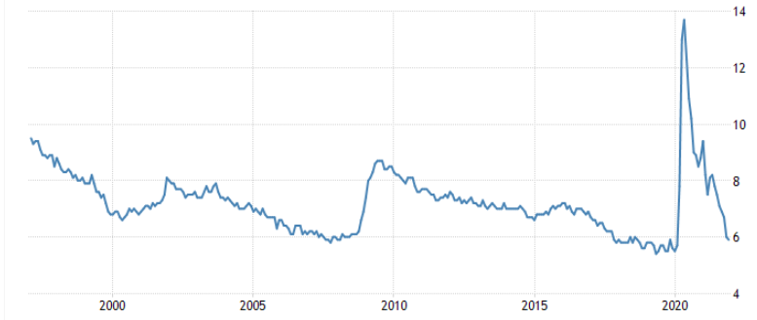
Which line is Unemployment Rate and which line is GDP growth?
Notes:
Source: https://tradingeconomics.com/canada/unemployment-rate

Slide 18
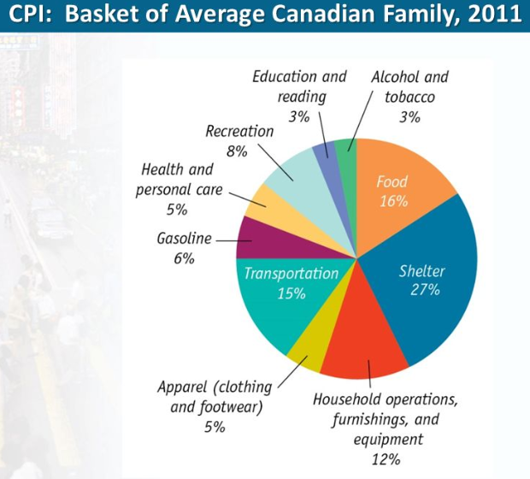
Measuring the economy: inflation
Consumer Price Index (CPI): measures the monthly average change in prices of goods and services
Market Basket: compilation of the goods and services most commonly purchased by urban consumers
Target annual inflation range in Canada: 1 to 3%
https://www.youtube.com/watch?v=qfKmJe3CK6E
Notes:
http://slideplayer.com/4725598/15/images/39/CPI%3A+Basket+of+Average+Canadian+Family%2C+2011.jpg

Slide 19
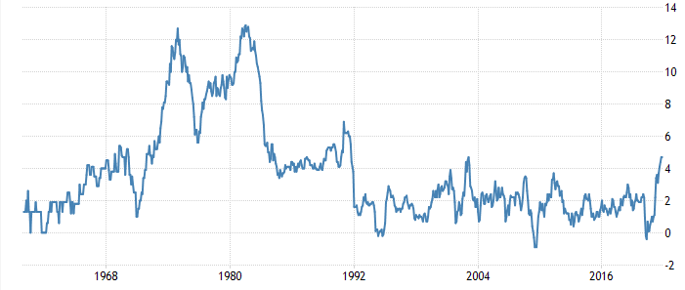
Measuring the economy: inflation in Canada (1960 to current)
Inflation has increased since the COVID pandemic began. Why?
Notes:
https://tradingeconomics.com/canada/inflation-cpi
Why has inflation increased? Various reasons – pent up demand after businesses re-opened, supply chain disruptions, government issued stimulus cheques, etc.

Slide 20
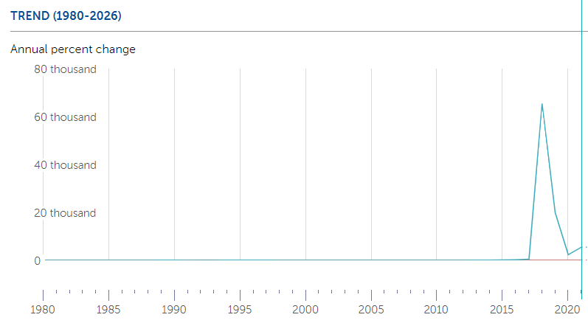
Example: hyperinflation in venezuela
2019 inflation: 9,585%
2020 inflation: nearly 3,000%
https://www.youtube.com/watch?v=JlCn9cCWwbo
Notes:
Sources:
https://www.imf.org/external/datamapper/PCPIPCH@WEO/WEOWORLD/VEN
https://guardian.ng/news/world/venezuela-reports-2020-inflation-of-3000-percent/

Slide 21
Measuring the economy: forecasting
Economic indicators are statistics about the economy (typically published by Statistics Canada)
Lagging economic indicators
Look at past data
E.g., average length of unemployment
Leading economic indicators
Try to predict the economy
E.g., new home sales
E.g., consumer confidence index

Slide 22
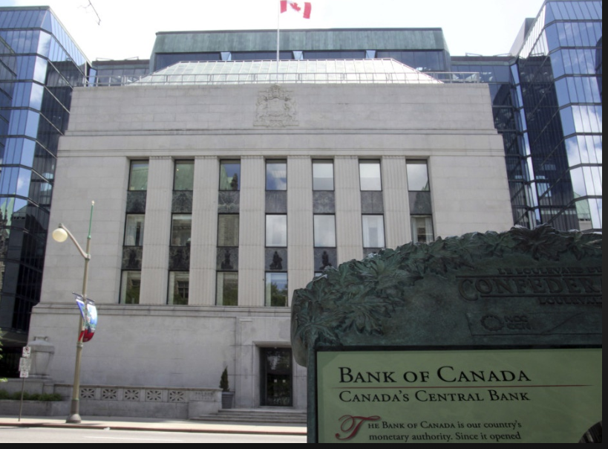
Government role in the economy: monetary policy
Managed by a country’s central bank (Bank of Canada)
Responsible for money supply of Canada
Lending money to the banks in Canada
Primary tool is control of short-term interest rates
Notes:
https://altcointoday.com/wp-content/uploads/2017/05/Bank-of-Canada-building.jpg

Slide 23


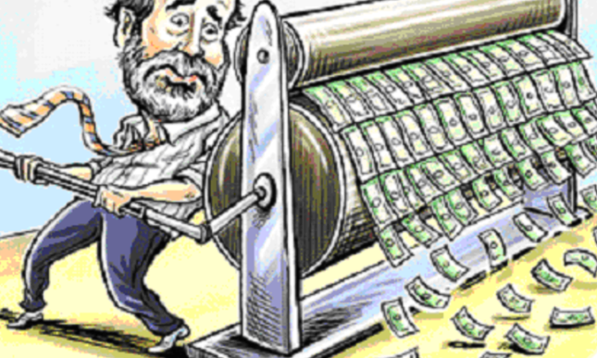

governments manage the economy through Monetary policy
Primary tool: interest rates
When inflation is high governments may decrease money supply
Interest rates
Slows economy
Lowers inflation
When economy is in recession governments may increase money supply
Interest rates
Stimulates economy (spending)
Stimulates inflation
Not a good idea for a government to simply print more money!! (video)
Notes:
http://res.cloudinary.com/real-progressives/image/upload/c_fill,g_auto,h_460,w_770/v1/news/community/2017-01-26-what-if-the-government

Slide 24
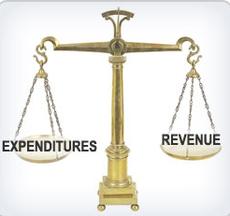
Government role in the economy: fiscal policy
Primary tools: taxes and government spending
When economy is in a recession
Want to stimulate growth – Decrease taxes? Increase government spending?
When inflation is high
May want to contract – Increase taxes? Decrease government spending?
Notes:
https://apps.irs.gov/app/understandingTaxes/whys/thm04/les01/media/ac4_thm04_les01.jpg

Slide 25



Government deficit/surplus and debt
https://worlddebtclocks.com/canada
Deficit: government spends more money than it receives (calculated on a yearly basis)
Surplus: government receives more money than it spends (calculated on a yearly basis)
Debt: the accumulation of deficits year after year (surpluses reduce the overall debt amount)
Measured at national level, provincial level, and municipal level = lots of debt!
Notes:
https://worlddebtclocks.com/Canada
https://www.michaeljournal.org/images/books/economic-democracy/Iceberg.jpg

Slide 26
Relevance for business owners & project managers
As a business owner…
Recessions may threaten your business (sales decrease)
Government monetary and fiscal policies affect your profits (taxes) & the cost of borrowing money
Depending on the type of competition, you may (or may not) be able to raise prices successfully
If inflation increases, cost of factors of production (e.g., wages) will likely increase – you may have to raise prices of your products & services
When unemployment rate is low, it’s harder to find workers
As a project manager…
Price instability (inflation) can cause budget risk for long-term projects!
If you are involved in international projects, there may be a lot of economic risk in the country where you are running the project ($$$)

